Slide 1
Market Outcomes and Tax Incidence
5
Notes:
Pre-class music: “Father Christmas” by The Kinks (See Tip #163)
This song is a good example of the deadweight loss of gift giving, because the kids in the song prefer cash to gifts for Christmas. After playing this song for students, you could open up a discussion by asking them to think about the gifts they’ve received in the past year.
Ask students to estimate the market value of those gifts.
Then ask whether they would have preferred the gifts or the cash value.
If for some, cash is preferable, why not just give people cash?

Slide 2
Previously
Different elasticity measures:
  Price elasticity of demand
  Income elasticity of demand
  Cross-price elasticity of demand
  Price elasticity of supply
Adding elasticity to our demand-supply models provides additional insight.
Notes:
Lecture tip:
Review the above points, which were covered by the previous chapter, if needed.
Determinants of price elasticity of demand include:
Availability of substitutes
Share of budget
Necessities or luxuries
Broad or narrow definition of market
Time and adjustment process
It’s a good idea to also remind students of the relationship between price elasticity and total revenue. When demand is elastic, total revenue increases as price decreases; when demand is inelastic, total revenue increases as price increases.
Income elasticity and normal and inferior goods
Cross-price elasticity and substitute and complementary goods
Determinants of price elasticity of supply: flexibility of producers and time
The effects of a demand (supply) shift on price and quantity depend on the elasticity of supply (demand), both in the short run and long run

Slide 3
Dutch Auction
Before we begin some new material, we are going to auction off this bundle of goods.
  We will hold a Dutch auction.
  Note that prices start high and fall.
  The first one to bid at the current price wins and pays that price.
Notes:
Classroom demonstration: Dutch Auctions
This demonstration can be found in the Interactive Instructor’s Guide (See Tip #192).
Bring a small bundle of goods to class. (Make sure to keep the receipt!) These goods could include milk and donut holes, soda and Pop-Tarts, soda and chips, a coffee mug with your school logo, and so on. Once you have decided on what good to auction, enter it in the PowerPoint slide.
Start by listing a high price, and then list smaller and smaller prices until someone says “Yes!”
That person is the winner and must pay the price. There is only one bidder. Then, show the receipt to the student and class.
Although the concepts that this demonstration covers are yet to be defined, the demonstration can show that both you and the student may have gained from the exchange. They may have paid more than you paid but less than what they would be willing to pay.

Slide 4
Big Questions
What are consumer surplus and producer surplus?
When is a market efficient?
Why do taxes create deadweight loss in otherwise efficient markets?
Notes:
Lecture notes:
Consumer and producer surplus are the gains from trade.
If markets are efficient, all the gains from trade are exhausted; the sum of consumer and producer surplus are maximized.
Taxes influence the incentives that people and firms face when consuming and producing goods that are taxed, and reduce the amount of activity that otherwise would have occurred.

Slide 5
What Are Consumer and Producer Surplus?
Welfare economics
  The study of how the allocation of resources affects economic well-being
Welfare is composed of two measures of market value:
  Consumer surplus
  Producer surplus
Notes:
Lecture tip:
Point out to students that there is a difference between economic welfare and people’s general idea of what welfare means.
Think of economic welfare as a measure of how well off or how efficient the market is.
Higher economic welfare means more gains from trade are being realized.
For now, think of consumer and producer surplus as the gains buyers and sellers get from trading in a market.

Slide 6

Consumer Surplus—1
Suppose there are three students who have different willingness to pay (WTP) for a textbook.
Notes:
Lecture notes:
WTP is the maximum price a consumer will pay for a good or service (reservation price). WTP depends on buyers’ preferences and how much money they may have.
You can relate this to quantity demanded (how much people are willing and able to buy).
[© DreamWorks/Courtesy Everett Collection]

Slide 7
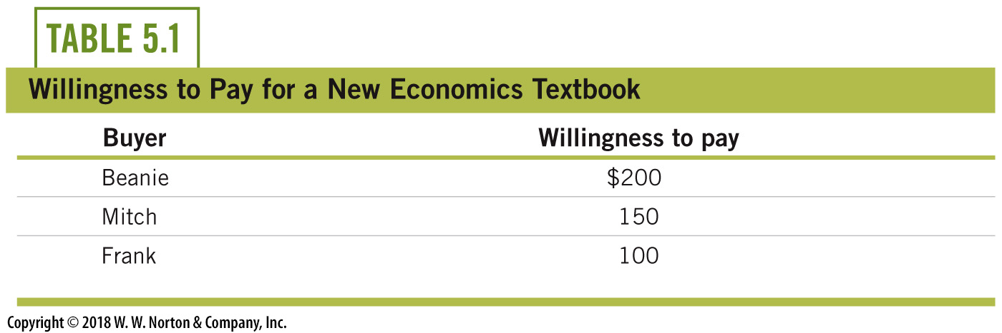
Consumer Surplus—2
Who buys the book if the price is $140?
Notes:
Lecture notes:
Beanie and Mitch buy the book since their WTP is > the price.
Once this is revealed, address the issue of what happens if WTP = Price.

Slide 8
Consumer Surplus—3
Consumer surplus is the difference between willingness to pay for a good and the price actually paid to get the good.
How much consumer surplus does Beanie get? Mitch?
CS = $200 - $140 = $60
CS = $150 - $140 = $10
Notes:
Lecture tip:
Ask students how much CS they get.
First click:
Beanie is willing to pay $200 for the book and pays $140, so his consumer surplus = $60.
Second click:
Mitch is willing to pay $150 for the book and pays $140, so his consumer surplus = $10.

Slide 9
Using Demand to Illustrate Consumer Surplus
Notes:
Image: Animated Figure 5.1
Lecture notes:
First click:
Plots out a step demand curve.
With this click, point out why it looks different than the demand curves students have seen so far.
At any price above $0, the quantity demand is zero.
Second to fourth clicks:
Labels each person’s willingness to pay.
At any price between $150 and $200, Beanie is the only buyer, so the quantity demanded is 1.
At prices between $100 and $150, Beanie and Mitch are each willing to buy the textbook, so the quantity demanded is 2.
Finally, if the price is $100 or less, all three students are willing to pay to buy the textbook, so the quantity demanded is 3.
As the price falls the quantity demanded increases.

Slide 10
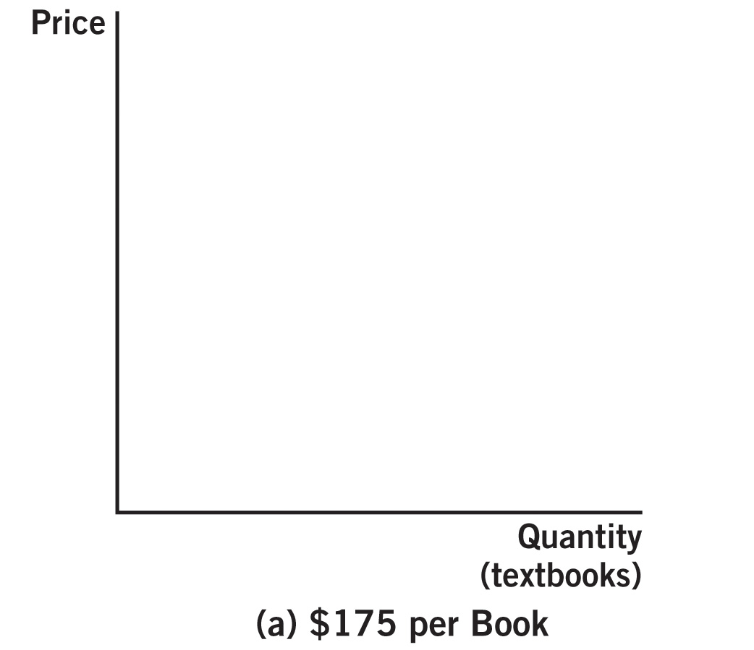
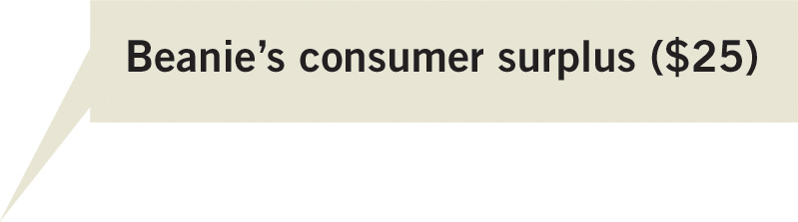
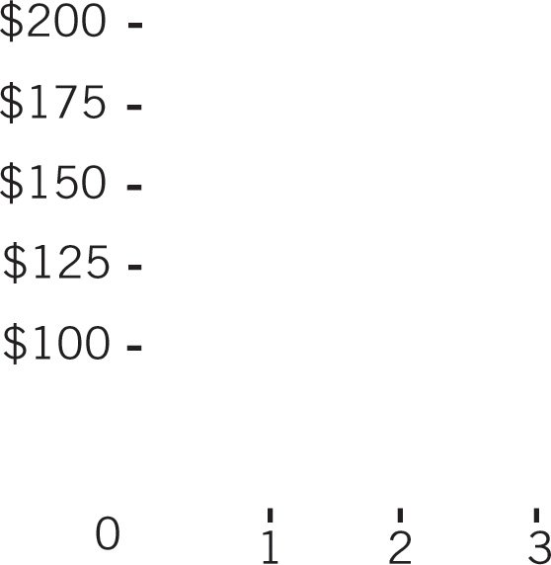
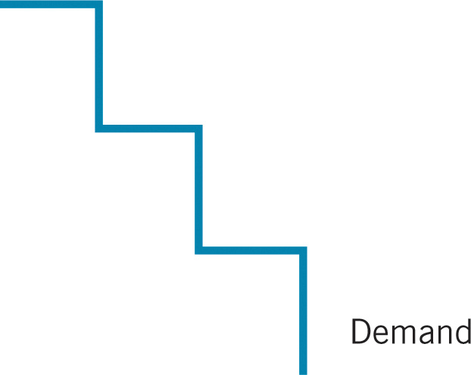


Consumer Surplus, Graphically—1
Notes:
Image: Animated Figure 5.2A
Lecture notes:
Consumer surplus when the price is $175.
First click:
Labels Beanie’s CS.
$175 is less than Beanie’s WTP, so he buys.
By buying the textbook, Beanie is better off by $25.
That’s his consumer surplus.
Note that if P = $175, that is more than Mitch’s and Frank’s WTP, so they won’t buy.

Slide 11
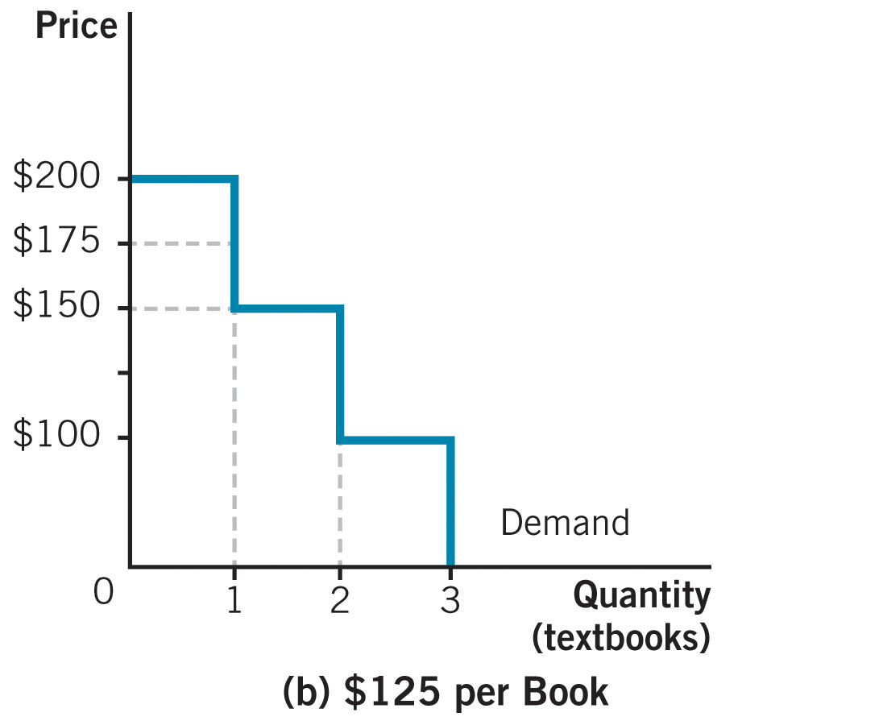
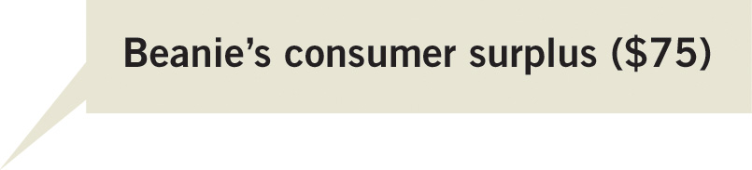




Consumer Surplus, Graphically—2
Notes:
Image: Animated Figure 5.2B
Lecture notes:
Consumer surplus when the price is $125.
First click:
Labels Beanie’s CS.
$125 is less than Beanie’s WTP, so he buys and his consumer surplus is $200 – $125 = $75.
Second click:
Labels Mitch’s CS.
Now at the lower price, Mitch decides to buy a textbook, since the price is less than his WTP.
Mitch’s willingness to pay is $150, so his consumer surplus, represented by the pink-shaded square, is $25.
$125 is still more than Frank’s WTP, so he will not buy a textbook.
Note that as price falls:
Quantity demanded increases
Consumer surplus has increased
Lower prices are good for consumers since they allow more people to purchase a good and increase the gains from trade.

Slide 12
Producer Surplus—1
Instead of buying a textbook, suppose Beanie, Mitch, and Frank are thinking about tutoring.
What is their willingness to sell (WTS)?
Notes:
Lecture notes:
WTS is the minimum price a seller will accept for a good or service.
WTS depends on each seller’s direct and indirect costs (opportunity costs).
Beanie has his own business, so he has a higher opportunity cost than Frank, who does not work.
Mitch, the business student, gives up time he could be studying.
You can relate this to quantity supplied (how much people are willing and able to buy).
[© DreamWorks/Courtesy Everett Collection]

Slide 13
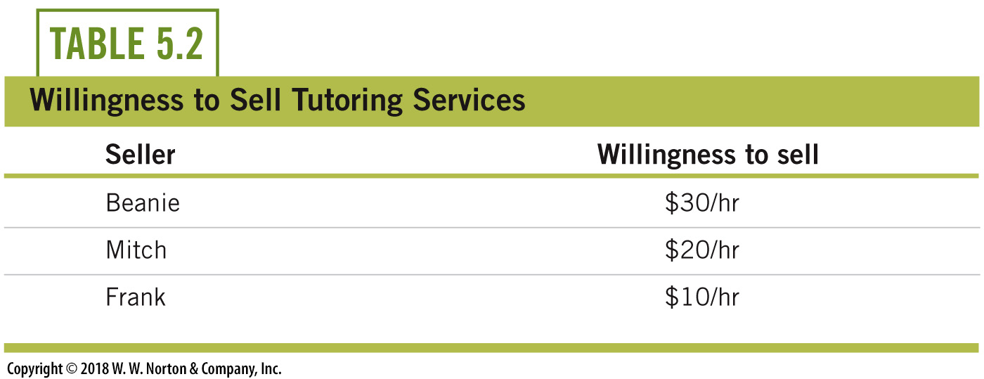
Producer Surplus—2
Which students will tutor if the market price is $25 per hour?
Notes:
Lecture notes:
Mitch and Frank will offer their tutoring services since their WTS, the lowest price at which they are willing to tutor, is less than $25.

Slide 14
Producer Surplus—3
Producer surplus—difference between willingness to sell a good and the price actually received for that good
How much producer surplus do Mitch and Frank get?
PS = $25 - $20 = $5
PS = $25 - $10 = $15
Notes:
Lecture notes:
Ask students how much producer surplus each person gets.
First click:
Mitch is willing to tutor for $20 per hour.
Since he would get $25, his producer surplus = $25 – $20 = $5.
Second click:
Frank is willing to tutor for $10 per hour.
Since he would get $25, his producer surplus = $25 – $10 = $15.
Beanie won’t tutor since the least amount he will accept for tutoring is $30 per hour, which is more than $25.

Slide 15
Using Supply to Illustrate Producer Surplus
Notes:
Image: Animated Figure 5.3
Lecture notes:
First click:
Plots out a step supply curve.
Point out to students why it looks different than the supply curves they have seen so far.
At any price below $10, the quantity supplied is zero.
Second to fourth clicks:
Labels each person’s willingness to sell.
At any price between $10 and $20, Frank is the only seller, so the quantity supplied is 1.
At prices between $20 and $30, Frank and Mitch are each willing to sell tutoring services, so the quantity supplied is 2.
Finally, if the price is $30 or more, all three students are willing to tutor, so the quantity supplied is 3.
As the price falls, the quantity supplied increases.

Slide 16
Producer Surplus, Graphically—1
Notes:
Image: Animated Figure 5.4A
Lecture notes:
Producer surplus when the price is $15.
First click:
Labels Frank’s PS.
$15 is more than Frank’s WTS, so he sells.
By tutoring, Frank is better off by $5.
That’s his producer surplus.
Note that if P = $15, that is less than Mitch’s and Beanie’s WTS, so they won’t tutor.

Slide 17
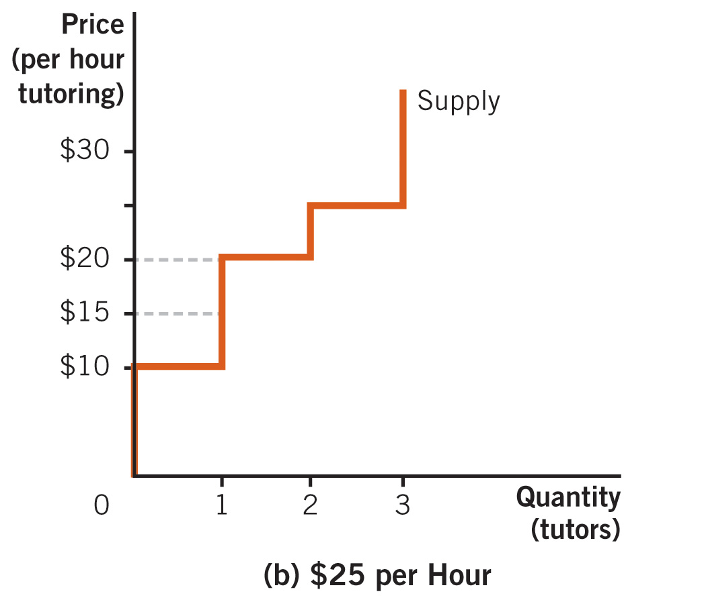




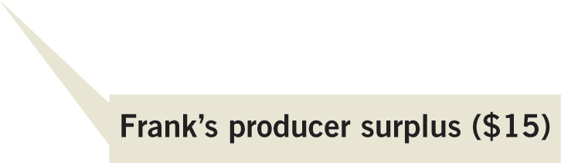
Producer Surplus, Graphically—2
Notes:
Image: Animated Figure 5.4B
Lecture notes:
Producer surplus when the price is $25.
First click:
Labels Frank’s PS.
$25 is more than Frank’s WTS, so he sells, and his producer surplus is $25 – $10 = $15.
Second click:
Labels Mitch’s PS.
Now, at the higher price, Mitch decides to tutor, since the price is more than his WTS.
Mitch’s willingness to sell is $20, so his producer surplus (represented by the pink-shaded square) is $5.
$25 is still less than Beanie’s WTS, so he will not tutor.
Note that as price rises:
Quantity supplied increases
Producer surplus increases
Higher prices are good for producers since they allow more people to sell a good and increase the gains from trade.

Slide 18
Practice What You Know—1
The height of the demand curve at any quantity can be thought of as the
  willingness to buy.
  willingness to sell.
  consumer surplus.
  producer surplus.
Notes:
Clicker question:
Correct answer: A, willingness to buy.
Willingness to buy (or willingness to pay) is the height of the demand curve.
CS = (height of demand) – (price actually paid)

Slide 19
Practice What You Know—2
The difference between the price the good was sold at and the minimum price the firm would have accepted for the good is called
  willingness to sell.
  product markup.
  producer surplus.
  price-cost margin.
Notes:
Clicker question:
Correct answer: C, producer surplus.
Willingness to sell is the height of the supply curve.
PS = (price actually received) – (height of the supply curve).

Slide 20
Economics in The Bourne Identity
How much money would you want for driving a stranger to Paris?
Notes:
“Economics in the Media” Slide
Lecture tip:
The clip mentioned on the slide can be found in the Interactive Instructor’s Guide. Access the direct link by clicking the icon in the PowerPoint above.
The key concepts covered in this clip are:
Consumer and producer surplus
Gains from trade
Elasticity
Bourne is desperate to find a ride to Paris, so he offers $10,000 to a stranger for a lift.
She needs the money, but is reluctant to take him up on it.
Why would someone offer that much money unless there is something wrong?
She agrees to help him after he offers to pay her an additional $10,000.
After showing students this clip, you can ask them the following questions:
How would you evaluate their consumer and producer surplus, and the gains from trade?
Is Bourne’s demand elastic or inelastic?

Slide 21
Economics in Just Go With It
How much would you want to be paid to pretend you are someone’s daughter or son?
Notes:
“Economics in the Media” Slide
Lecture tip:
The clip mentioned on the slide can be found in the Interactive Instructor’s Guide. Access the direct link by clicking the icon in the PowerPoint above.
The key concepts covered in this clip are:
Consumer and producer surplus
Gains from trade
Supply and demand
Adam Sandler negotiates with a young girl to convince her to pretend to be his daughter.
They settle on $300, and a three-week acting camp.
He would’ve paid $500, whereas she would’ve done it for the experience.
After showing students this clip, you can ask them the following questions:
How much was Sandler’s consumer surplus?
WTP = $500, but P = $300, so $200.
How much was the girl’s producer surplus?
P = $300, WTS = $0, so $300.

Slide 22
When Is a Market Efficient?
How do economists measure social welfare?
  Total surplus = CS + PS
  CS and PS represents the gains from participating in the market.
  Want to show how total surplus is maximized in markets without government intervention
  An outcome is efficient when an allocation of resources maximizes total surplus.
Notes:
Lecture notes:
Economic welfare is a sign of how well off or how efficient our economy is at capturing gains from trade. An increase in economic welfare is a good thing.

Slide 23
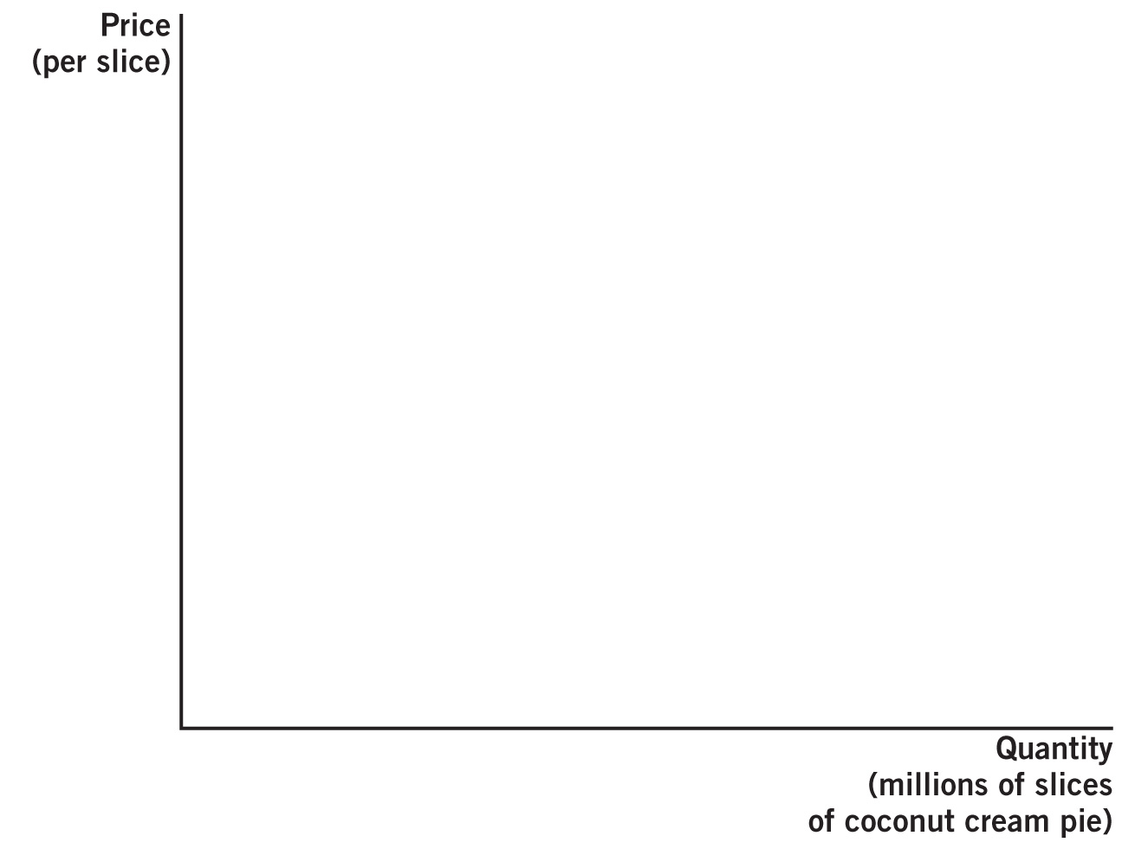
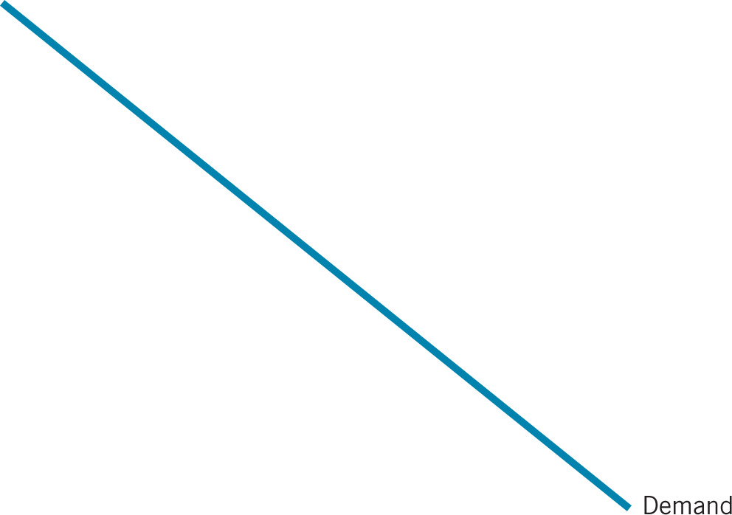
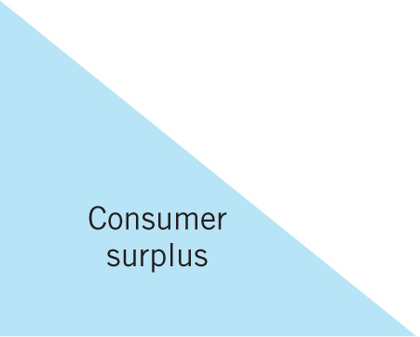

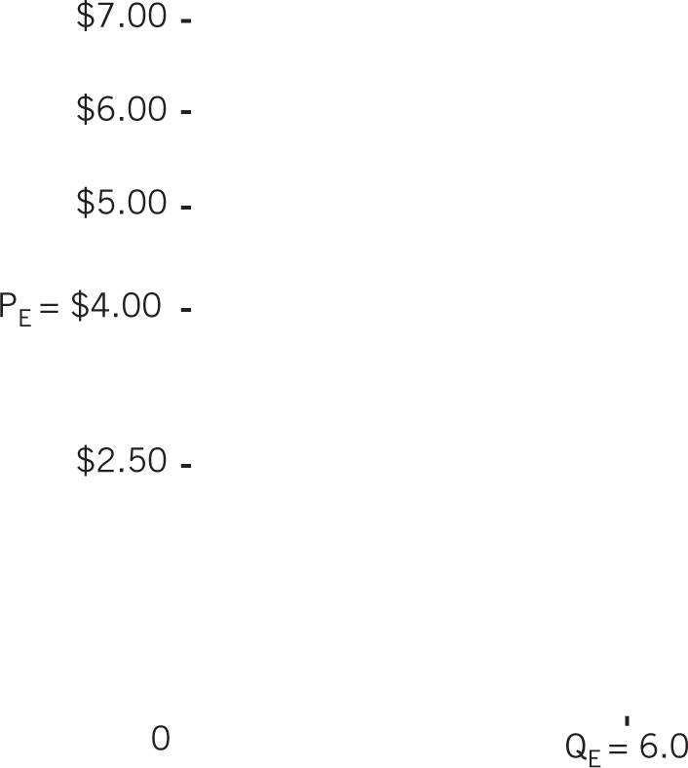
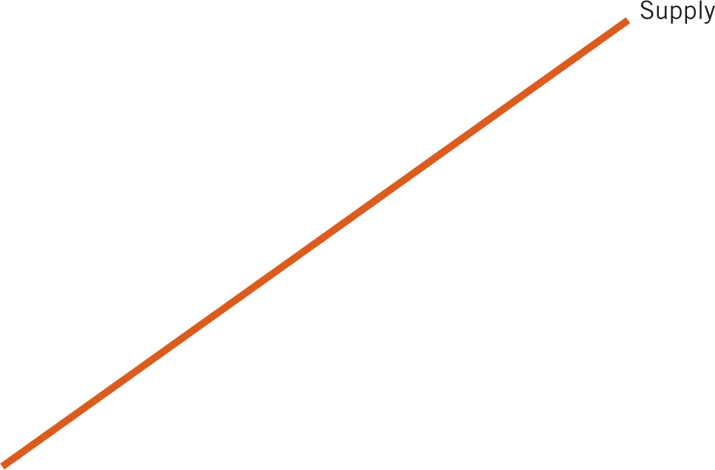

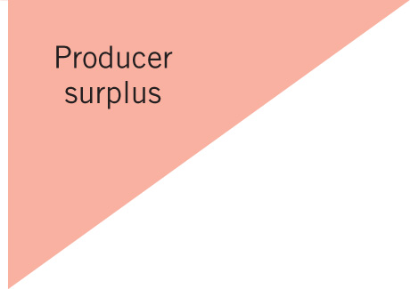


CS and PS for a Slice of Pie—1
Notes:
Image: Animated Figure 5.5
Lecture notes:
The demand curve shows that some customers are willing to pay more for a slice of pie than others are.
The supply curve shows that some producers are willing to accept less for a slice of pie than others are.
First click:
Labels price of $4 and Q of 6.0 million slices, and different prices
Before you move on to the next click, ask students where CS and PS are.
Second click:
Shades in CS triangle.
CS is the area below the demand curve but above the price of $4.
At point A, there is some consumer who is willing to pay $7. He or she pays $4, so CS = $3.
At point B, there is another consumer who is willing to pay $5. He or she pay $4, so CS = $1.
Third click:
Shades in PS triangle.
PS is the area above the supply curve but below the price of $4.
At point C, there is some producer who is willing to accept $2.50. He or she receives $4, so PS = $1.50.
Total surplus:
The shaded-blue triangle (consumer surplus) and the shaded-red triangle (producer surplus) = total surplus or social welfare.
Efficiency occurs at point E when the market is in equilibrium. At any other non-equilibrium price, less trading will occur, and less surplus will be gained.

Slide 24
CS and PS for a Slice of Pie—2
Notes:
Image: Animated Figure 5.5
Lecture notes:
Why is total surplus maximized at 6.0 million slices? Go through some counter examples with students.
First click:
Why not have more than 6.0 million slices? After all, there are buyers who are willing to pay for a slice of pie.
You can counter this question by explaining that for any quantity more than 6.0 million slices, the maximum amount a buyer is willing to pay is less than the minimum amount a seller is willing to trade.
Second click:
What if we restrict trade to less than 6.0 millions slices?
Now there are some buyers who are willing to pay more than what some sellers are willing to accept.
Therefore, there are potential gains from trade.
Third click:
These potential gains are represented by the green triangle (later, we’ll call this DWL).

Slide 25
Economics in The Office, “Christmas Party”
Secret Santa versus Yankee Swap
Notes:
“Economics in the Media” Slide
Lecture tip:
The clip mentioned on the slide can be found in the Interactive Instructor’s Guide. Access the direct link by clicking the icon in the PowerPoint above.
The key concepts covered in this clip are:
Deadweight loss of gift giving
Trade creates value
Exchange
After showing students this clip, you can ask them:
Which scheme leads to less DWL?

Slide 26
Music Break: The Beatles, “Taxman”
How do taxes influence people’s behavior?
Notes:
“Economics in the Media” Slide
Lecture tip:
The song clip mentioned on the slide can be found in the Interactive Instructor’s Guide. Access the direct link by clicking the icon in the PowerPoint above.
The key concepts covered by this song are:
Taxation
Wealth
After playing students this song, you can ask them the following questions:
Would high tax rates encourage people to move to another country?
What tradeoffs would they face?
Make sure to discuss how, in general, taxes discourage certain types of behavior.

Slide 27


Taxation, Welfare, and Deadweight Loss
Why do we pay taxes?
What are some different types of taxes?
What are excise taxes?
Notes:
Lecture notes:
Taxes pay for many services society needs. Such services could include:
Police
Military
Infrastructure
Some different types of taxes could include:
Taxes paid on income
Payroll
Property
Corporate profits
Sales
Inheritance
Excise taxes are taxes imposed on a particular good or service. Such goods and/or services could include:
Cigarettes
Alcohol

Slide 28
Tax Incidence
Suppose the government imposes an excise tax on milk.
  Who pays for the tax?
Tax incidence
  The burden of taxation on the party who pays the tax through higher prices
  Occurs regardless of whom the tax is actually levied on
Notes:
Lecture notes:
Point out that we want to show that the incidence or burden of the tax is independent of who is legally obligated to pay the tax.

Slide 29
Tax on Buyers
Notes:
Image: Animated Figure 5.6
Lecture notes:
Without the tax, the equilibrium price is $4.00 and the equilibrium quantity is 1,000 gallons.
What happens if the government imposes a $1.00 tax paid by the buyers of milk?
First click: Demand curve shifts from D₁ to D₂.
The new demand curve reflects how much consumers are willing and able to pay for a gallon of milk not including the $1 tax.
Point out that the vertical distance between the two demand curves is the amount of the tax (= $1).
Second click: Labels new equilibrium.
The equilibrium price and quantity is $3.50 and 750 gallons.
The $3.50 is the price paid to the seller.
But since the consumer has to pay the $1.00 tax, they pay a full price of $4.50.
Tax incidence:
Consumers initially paid $4.00 per gallon, and now pay $4.50 per gallon. They pay $0.50 more.
Producers initially received $4.00 per gallon, and now receive $3.50. They receive $0.50 less.
In this example, the burden of the tax falls equally on both consumers and producers.
How much does the government collect in tax revenue?
Tax revenue = (tax amount) × (number of units taxed)
Tax revenue = $1.00 × 750 = $750

Slide 30
Tax on Sellers
Notes:
Image: Animated Figure 5.7
Lecture notes:
Without the tax, the equilibrium price is $4.00 and the equilibrium quantity is 1,000 gallons.
What happens if the government imposes a $1.00 tax paid by the sellers of milk?
First click: Supply curve shifts from S₁ to S₂.
The new supply curve reflects the minimum price sellers would need to receive to sell a gallon of milk.
Note that the supply curve includes the $1.00 tax.
Point out that the vertical distance between the two supply curves is the amount of the tax (= $1).
Second click: Labels new equilibrium.
The equilibrium price and quantity is $4.50 and 750 gallons.
The $4.50 is the price paid to the seller by the buyers.
But since the producers have to pay the $1.00 tax to the government, they actually receive a price of $3.50.
Tax incidence:
Consumers initially paid $4.00 per gallon and now pay $4.50 per gallon. They pay $0.50 more.
Producers initially received $4.00 per gallon and now receive $3.50. They receive $0.50 less.
In this example, the burden of the tax falls equally on both consumers and producers.
How much does the government collect in tax revenue?
Tax revenue = (tax amount) × (number of units taxed)
Tax revenue = $1.00 × 750 = $750

Slide 31
Comparing Both Cases
Tax levied on consumers:
  Some of the burden is passed to producers since the market price falls.
Tax levied on a business:
  The firm will attempt to raise prices to pass some of the burden to consumers.
Incidence:
  Incidence is the same.

Slide 32
Deadweight Loss
So far we have shown that a tax hurts both buyers and sellers.
  Buyers pay a higher price, and sellers receive a lower price.
What did we miss?
Deadweight loss:
  The decrease in economic activity caused by market distortions.
Notes:
Lecture notes:
We missed that there are now less gallons of milk exchanged: 1,000 to 750.
Remind students that markets are efficient when total surplus or the sum of consumer and producer surplus is maximized.
At equilibrium, all the gains from trade are exhausted.
By imposing a tax, the government causes the quantity of gallons of milk to fall and so reduces total surplus in the milk market.
The loss in surplus is deadweight loss.
Steve Landsberg asks, “Why are taxes bad?”
Because we don’t like to pay them.
And the only legal way we can avoid paying them is by reducing engaging in the activity that is being taxed.

Slide 33
Deadweight Loss, Graphically
Notes:
Image: Animated Figure 5.8
Lecture notes:
This graph shows DWL in the case of a tax levied on the buyer. The effect of the tax is to reduce the amount purchased from 1,000 to 750 gallons.
First click:
Adds DWL triangle.
The top half of the yellow triangle represents the loss in consumer surplus; the bottom half of the yellow triangle represents the loss in producer surplus.
These are possible gains from trade that the tax eliminates.
How much is the DWL?
= ½ x (1,000 – 750) x ($4.50 – $3.50) = $125
Here’s an example to give students to enforce the idea of DWL:
Suppose the government could magically transfer the tax revenue collected back to consumers and producers.
Consumers and producers would each receive $375 ($0.50 x 750).
Why doesn’t that make consumers and producers whole?

Slide 34
Tax, Deadweight Loss, and Elasticity—1
How does tax incidence and DWL change depend on the elasticity of demand?
  When demand is inelastic (elastic), Q_{D} is relatively unresponsive (responsive) to a change in price.
  The more inelastic demand is, the greater the burden on consumers and the smaller the DWL.
Notes:
Lecture notes:
We will show that:
When demand is perfectly inelastic, the burden of the tax falls entirely on the consumer, and there is no DWL.
As demand becomes more elastic, consumer burden falls, and DWL increases.

Slide 35
Tax and DWL with Perfectly Inelastic Demand
Notes:
Image: Animated Figure 5.9
Lecture notes:
First, explain/reveal the left graph, which shows the market before the tax.
First click: Draws demand and supply curve.
Refresh students’ memory on why the demand curve is vertical.
You may also want to discuss whether the demand for phone service is perfectly inelastic.
Second click: Labels equilibrium P and Q.
Third click: Labels PS and CS.
After this click, students might ask whether CS is infinite. (Does the demand curve keep going?)
Then, explain/reveal the right graph, which shows the market after the tax.
Fourth click: Draws demand and supply curves.
Fifth click: Draws new supply curve from S₁ to S₂.
Sixth click: Labels initial and new equilibrium prices.
Equilibrium moves from E₁ to E₂, and the price rises from P₁ to P₂.
Since demand is perfectly inelastic, a price increase does not affect quantity demanded; it remains at Q₁.
Seventh click: Labels tax and tax revenue (the green-shaded area).
Eighth click: Labels PS and CS.
Since the price producers receive remains the same, producer surplus is the same as before.
Since consumers pay a higher price, consumer surplus falls by the amount of the tax revenue.
Since quantity remains the same, there is no DWL.
Finally, once both graphs have been revealed, compare the two pictures:
In both cases, total surplus is the same and as large as possible.
The difference is that with the tax, part of the surplus is redistributed from consumers to the government.
You can follow this up by leading a discussion:
Even though total surplus is the same and there is no DWL, are there other issues to consider?
In the first case, consumers would have more money to spend on other goods.
In the tax case, the government spends the money.

Slide 36
Tax, Deadweight Loss, and Elasticity—2
Why would the government want to tax a good with almost perfectly inelastic demand?
  No substitution (ensures steady tax revenue)
  Purchases will not change very much
  So that there is little or no deadweight loss
  Do we tax Brussels sprouts or
  cigarettes?
Notes:
Lecture notes:
A “good” tax is one that leads to little or no distortions.
If we taxed Brussels sprouts, most consumer would buy something else so there is relatively larger deadweight loss.
But the demand for cigarettes is highly inelastic, so most of the burden of the tax falls on smokers, and there is a small DWL.

Slide 37
Tax and DWL with Somewhat Elastic Demand
Notes:
Image: Animated Figure 5.10
Lecture notes:
Assume that demand and supply are “equally” elastic here.
First explain/reveal the left graph, which is the case before the tax is imposed.
Total surplus is maximized, so no DWL.
Then explain/reveal the right graph:
First click: Draws supply curve with tax, and labels new equilibrium.
As we saw before, the price will increase, but by less than the amount of the tax.
In this case, the burden of the tax falls on both consumers and producers.
Note that the graphs are drawn so that the tax burden is shared equally, but it does not have to be.
Second click: Adds tax and tax revenue box.
Point out that even though the tax per unit is the same, the amount of tax revenue the government collects is less than the case when demand was perfectly inelastic.
Third click: Shades in CS and PS; both fall compared to the before tax case.
Fourth click: Shades in DWL.
DWL is a further indication of the decreased number of trades.
After the tax, this market is no longer economically efficient.

Slide 38
Tax and DWL with Perfectly Elastic Demand
Notes:
Image: Animated Figure 5.11
Lecture notes:
First, explain/reveal the left graph, which is the case before the tax is imposed.
Since demand is perfectly elastic, demand is horizontal.
You can ask students to give some examples of highly or perfectly elastic demands other than lettuce.
First click: Shades in PS.
There is no CS, so WTP = P*.
Total surplus is maximized, but all goes to producer and no DWL.
Next, explain/reveal the right graph.
Second click: Draws initial demand, supply, and equilibrium.
Third click: Draws new supply curve and new equilibrium.
Although the supply curve shifts up by the amount of the tax, equilibrium moves from E₁ to E₂.
The market price stays at P₁, but sellers have to pay the tax, so we end up with P₃.
Sellers bear the entire incidence of the tax.
Fourth click: Shaded in tax revenue.
Fifth click: Shaded in PS, which has fallen relative to the no tax case.
Sixth click: Shaded in DWL.

Slide 39
Comparing the Three Cases
If demand is perfectly inelastic, the burden of the tax falls on consumers but there was no DWL.
As demand becomes less inelastic (or more elastic) the tax burden starts to fall more on producers but there is a DWL.
If demand is perfectly elastic, the burden of the tax falls on producers and there is a larger DWL.
Notes:
Lecture notes:
This is a lesson for policymakers:
If the goal is to generate tax revenue or minimize efficiency losses, tax goods with relatively inelastic demand.

Slide 40
Practice What You Know—3
Deadweight loss can be thought of as surplus that is transferred from producers or consumers and given to
  the government.
  competitors in other markets.
  taxpayers.
  nobody.
Notes:
Clicker question:
Correct answer: D, nobody.

Slide 41
Practice What You Know—4
If the government wants to create tax revenues without generating any deadweight loss, what type of good should they tax?
  a good with a perfectly elastic demand
  a good with a relatively elastic demand
  a good with a perfectly inelastic demand
  a good with a relatively inelastic demand
Notes:
Clicker question:
Correct answer: C, a good with a perfectly inelastic demand

Slide 42
Interaction of Demand and Supply Elasticity
What would happen if we varied the elasticity of the supply curve as well as the demand curve?
Compare the elasticity of demand with the elasticity of supply.
Notes:
Lecture notes:
When the demand curve is more inelastic than the supply curve:
Consumers bear more of the incidence of the tax.
When the supply curve is more inelastic than the demand curve:
Producers bear more of the incidence of the tax.
If both demand and supply are relatively inelastic, deadweight loss is minimized.

Slide 43
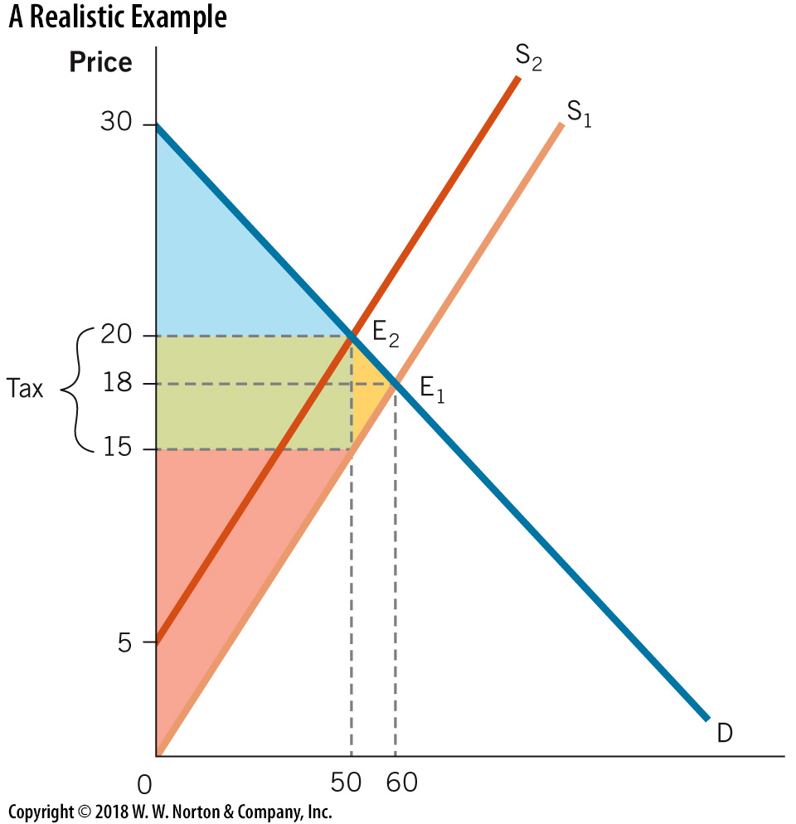
Realistic Example
Notes:
Image: Figure 5.12
Lecture notes:
A mushroom market starts with an equilibrium price of $18 and an equilibrium quantity of 60. A $5 per pound tax is placed on mushroom suppliers. At the new equilibrium, P = $20 and Q = 50.
We want to calculate tax incidence, DWL, and tax revenue.
Consumer incidence:
Consumers pay $2 or 2/5 or 40 percent of the $5 tax.
Consumer incidence = ($20 – $18) x 50 = $100.
Producer incidence:
Producer pays $3 or 3/5 or 60 percent of the $5 tax.
Produce incidence = ($20 – $17) x 50 = $150.
Incidence falls more on producer since the supply curve is more inelastic than the demand curve.
DWL:
DWL = ½ x (change in quantity) x (price paid by consumer – price earned by seller).
DWL = ½ x (60 – 50) x ($20 – $15) = $25.
Tax revenue = $5 x 50 = $250.
Note that the sum of producer and consumer incidence = tax revenue.

Slide 44

Balancing Deadweight Loss and Tax Revenues
What happens if the government increases a tax?
  Tradeoff between tax revenue and DWL
Ireland (2002): 15 cent tax on plastic bags
Notes:
Lecture notes:
The main point in this section is to look at the tradeoff between tax revenues and DWL.
Initially, as tax increases, government revenue is relatively large compared to the DWL.
As tax increases further, DWL increases relative to tax revenue.
To expand upon the example on the slide, in Ireland in 2002:
Tax led to a 90 percent decrease in consumption.
Ask students whether they think tax was imposed to raise revenue or if there was another purpose.

Slide 45
Deadweight Loss and Tax Revenue—1
Notes:
Image: Figure 5.13A
Lecture notes:
This is a basic supply and demand model.
It assumes relatively equal elasticities for supply and demand, so the tax burden is roughly the same.
Total welfare = CS + PS maximized, so there is no DWL.
The next four figures will show what happens as a larger and larger tax is imposed.

Slide 46
Deadweight Loss and Tax Revenue—2
Notes:
Image: Animated Figure 5.13B
Lecture notes:
First click:
Draws new supply curve and new equilibrium.
Second click:
Shades in tax revenue and DWL.
With small tax, tax revenue will be large relative to DWL.

Slide 47
Deadweight Loss and Tax Revenue—3
Notes:
Image: Figure 5.13C
Lecture notes:
Now, tax revenue is larger than before, but so is DWL.

Slide 48
Deadweight Loss and Tax Revenue—4
Notes:
Image: Figure 5.13D
Lecture notes:
With a very large tax, tax revenue is smaller than before, and DWL is much larger.

Slide 49
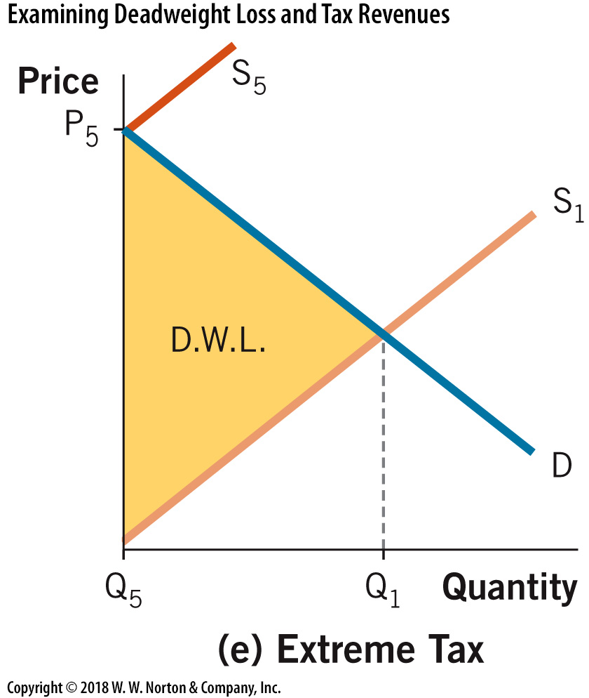
Deadweight Loss and Tax Revenue—5
Notes:
Image: Figure 5.13E
Lecture notes:
In this last case, the tax is so high that the quantity exchanged falls to zero.

Slide 50
Real-World Example: Smoking Tax versus Smoking Ban
Why tax a good if it reduces efficiency in the market by creating deadweight loss?
Which policy, tax or ban, would be more effective at reducing smoking?
Notes:
Real-world example: Smoking Tax versus Smoking Ban (See Tip #198)
Lecture notes:
The key concepts covered by this real-world example are:
Tax
Elasticity
Public policy
Raise tax revenues, decrease production/consumption of that good
Ban
Does not change price of cigarettes but does increase the opportunity cost of smoking
People could smoke the same amount but smoke in different locations
Could impose costs on others
Tax
Demand for cigarettes is very inelastic, so a relatively high tax would need to be imposed to affect consumption
Could end up with larger tax revenues, which could be used to fund public services

Slide 51
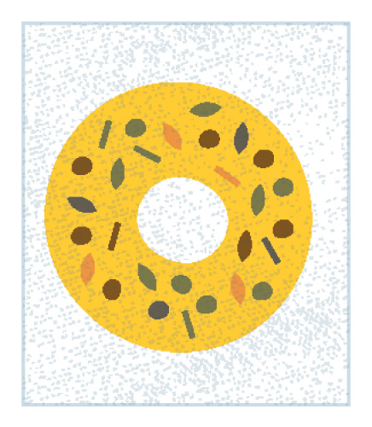

Unusual Taxes
What’s the purpose of the tax? How effective is it?
Bagel tax:
  In New York, a prepared bagel is subject to an 8 cent tax.
Window tax:
  England passed a tax in 1696 on windows on homes.
Notes:
Lecture notes:
The “bagel tax” is pretty common. For example, one would pay a higher tax for potato salad bought from the deli counter at his or her local grocery store than the same potato salad already in a prepackaged container.
The “window tax” was targeted towards wealthy households.
Windows in homes were expensive.
The homeowner got around paying the tax to some extent by bricking over the windows.

Slide 52
Economics in Seinfeld, “The Deal”
Jerry and Kramer give Elaine birthday gifts. Money or a bench?
Notes:
“Economics in the Media” Slide
Lecture tip:
The clip mentioned on the slide can be found in the Interactive Instructor’s Guide. Access the direct link by clicking the icon in the PowerPoint above.
The key concepts covered in this clip are:
Deadweight loss of gift giving
Signaling
Utility
After showing students this clip, you can initiate a class discussion on why a gift might be preferable to cash.
The typical response from students will be that a gift shows we care or we took time to find out what people wanted.
But what if someone gives them the cash value of the gift plus additional cash equal to the value of the time that it would have taken to obtain the gift?
What’s wrong with saying the amount of time spent finding that “right” gift signals that the person cares about them?

Slide 53
Conclusion
Unregulated markets are beneficial because they generate the largest possible total surplus.
Taxing specific goods leads to a deadweight loss, which reflects reduced economic activity.
Society must balance the benefits of government services that taxes pay for with the costs of the inefficiencies created in the market.
Notes:
Lecture notes:
You can summarize the lecture on this chapter by reiterating the following points:
Total surplus (CS + PS) measures the benefits that buyers and sellers enjoy from undertaking an activity.
Whenever an allocation of resources maximizes total surplus, the result is said to be efficient.
Although efficiency is one possible goal, an efficient outcome may not be equitable.
Tax incidence or burden is not the same as who is legally obligated to pay a tax.
Taxes lead to distortions and a deadweight loss.
A “good” tax is one that leads to a small deadweight loss.

